Slide 1
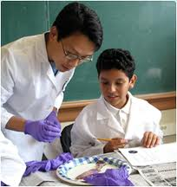
MAPS 1/25/2012
Summer 2012 Internship Opportunities

Slide 2
Summer Opportunities
“It’s June 1st 2012, What should I be looking forward to this summer?”
Freshmen and Sophomores
Attend a summer program which provides either exposure to the health professions or research experience
Juniors – who are applying
AMCAS Application Preparation
Should already have taken the MCAT by this point! If you have and did not like your score, determine whether you need to re-take it
This is a more comprehensive topic that we will discuss at a later date.
http://www.xula.edu/premed/PMInfo/a.AppSeries/a.IndexApp.htm

Slide 3
How Should You Spend your Summer?
Comprehension: Subscribe to Newsweek, Time, or a similar WEEKLY publication and start reading FROM COVER TO COVER EVERY WEEK.
Current Events: Listen to NPR (91.5 FM), Nytimes.com, CNN.com
Comprehension: Read at least two books. (This, like reading Newsweek or Time will also help with the MCAT.)
Put your critical thinking and verbal reasoning skills to the test
1) 10 Actual, Official LSAT PrepTests (the reading comprehension section offers good practice for the verbal sections of the MCAT, DAT, etc.)
2) ExamKrackers 101 Passages in MCAT Verbal Reasoning.
http://www.xula.edu/premed/PMInfo/a.AppSeries/a.IndexApp.htm

Slide 4
What’s Out There For Me?
Research
Volunteering
Work Experience
Shadowing
Notes:
These are not mutually exclusive! If you’re getting work experience, you can volunteer at the same time. Similarly, shadowing opportunities are a good avenue to get in contact w/ physicians and can give you clinic exposure for individual specialties which is always a plus. Make sure what you are doing doesn’t involve sitting on the couch, but getting out there and developing yourself in some positive way.

Slide 5
Google Is Your Friend
There are literally hundreds of PAID summer opportunities for students with free housing.
A Google Search:
Columbia University Summer Opportunities List
Rochester Institute of Technology Summer Opportunities List
NSF-Funded Research Opportunities
Notes:
Discuss Cost of living, location, stipend, free housing, transportation

Slide 6
Typical Requirements
Determine Field of Interest
Volunteering: Is it health/science-related?
Research: Microbiology, Chemistry, Engineering, Public Health, etc?
Work: Is it health/science-related?
If what you want to do isn’t health/science related, what other qualities can be drawn from the experience?
If it allows you to develop personally, academically, or professionally, DO IT.
Eligibility
Minorities, Open to Everyone
Class (Freshmen, Sophomore, etc).
GPA
Deadlines (Usually Late Winter, Early Spring)
Transcript
Resume/CV
Letters of Recommendation
Talk to your professors, go to office hours. This is VITAL.

Slide 7
Some Programs to consider…

Slide 8
Summer Undergraduate Research Fellowship (SURF)
June 4 - August 10, 2012 in Dallas, TX!
AMAZING opportunity if you’re interested in biomedical research
Work on a research project that interests you in the laboratories of UT Southwestern Graduate School faculty members
Attend weekly seminars by UT Southwestern faculty and receive graduate training
Stipend = $4,000
How to apply: Complete the SURF 2012 Application and mail transcript with two letters of recommendation
http://www.utsouthwestern.edu/education/graduate-school/programs/non-degree-programs/surf.html
Deadline: February 9, 2012

Slide 9
Summer Medical and Dental Enrichment Program (SMDEP)
SMDEP is a summer program intended for underrepresented minorities’ to help their skills in math, science, writing, and learning strategy. Participants receive instruction in ethics, professionalism, interviewing skills, clinical experience, and individual advising.
What’s needed? SMDEP web application, transcript, letters of recommendation.
Eligibility: Must be a first year or sophomore, have a minimum GPA: 2.5, be a U.S. citizen, and not have participated in SMDEP before.
Compensation: free on-campus housing, free meals (breakfast and dinner), up to $200 in travel assistance, a stipend received in 2 installments.
Website: http://www.smdep.org/start.html
Deadline: March 1st

Slide 10
The Leadership Alliance
The Leadership Alliance Summer Research Early Identification Program (SR-EIP), offers undergraduates, interested in pursuing a PhD or MD-PhD, the opportunity to work for eight to ten weeks under the guidance of a faculty or research mentor at a participating Alliance institution.
**This all expense paid summer internship provides students with a competitive stipend, travel and housing.
Deadline: February 1st, 2012
The Leadership Alliance

Slide 11
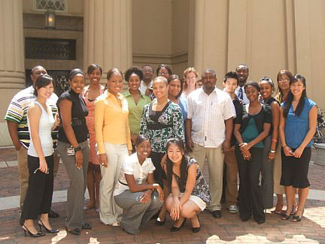
Summer Student Program in Microbiology, Infectious Diseases and Public Health Epidemiology
Where: Virginia Common Wealth University
What: Research in Infectious Diseases
When: May 29, 2012-July 27, 2012
Deadline: March 20, 2012
Website: http://www.medschool.vcu.edu/research/summer/midph.html

Slide 12
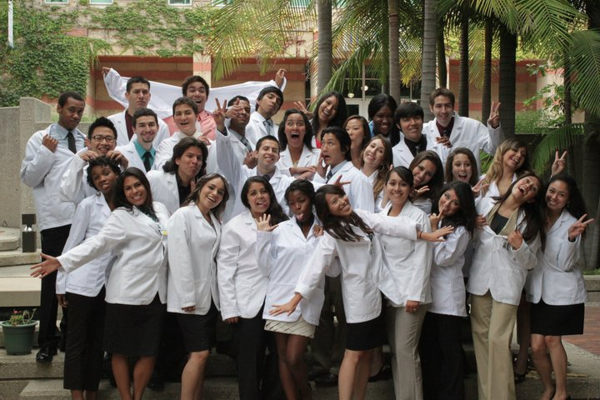
UCLA PREP
What’s in it for YOU?
Clinical Preceptorships
Career Guidance & Personal Development
Volunteer in underserved
Stipend of $2000
Networking
Mentorship

Slide 13
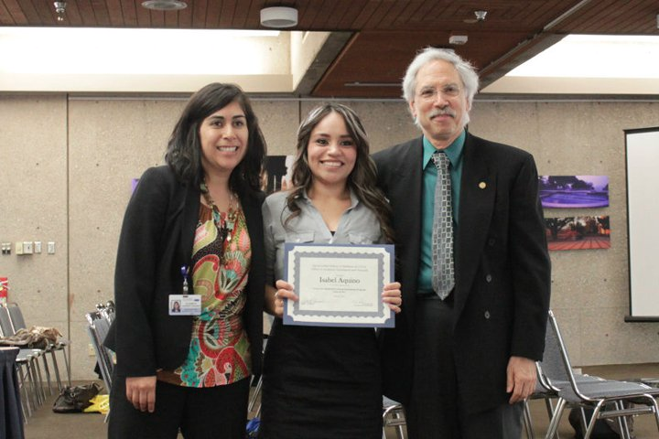
UCLA PREP continued
Requirements
2.5 GPA for sophomores & 2.8 GPA for juniors and above
Have a year of Biology or Chemistry
Where’s the application?
http://www.medstudent.ucla.edu/offices/aeo/prep.cfm
Deadline: March 1st

Slide 14
Research in Molecular pharmacology and Therapeutics WEBSITE: http://www.stritch.luc.edu/depts/pharmacology/index.cfm
WHERE: Loyola university in Chicago, Illinois
DURATION: 10 week program, may 29th – August 3rd 20102
WHAT: practical laboratory research experience mentored by faculty members of the department of molecular pharmacology and therapeutics. At the end of the 10 weeks each student will provide an oral presentation of their work to the department
REQUIREMENTS: transcript, 2 letters of recommendation and an essay indicating how this experience would help your career goals
COMPENSATION: stipend of $3,500 (this can be used for room, broad, or travel expenses)
ELIGIBILITY: U.S citizen or permanent resident, rising seniors or recent graduates
DEADLINE: 12:01 a.m. March 9, 2012

Slide 16
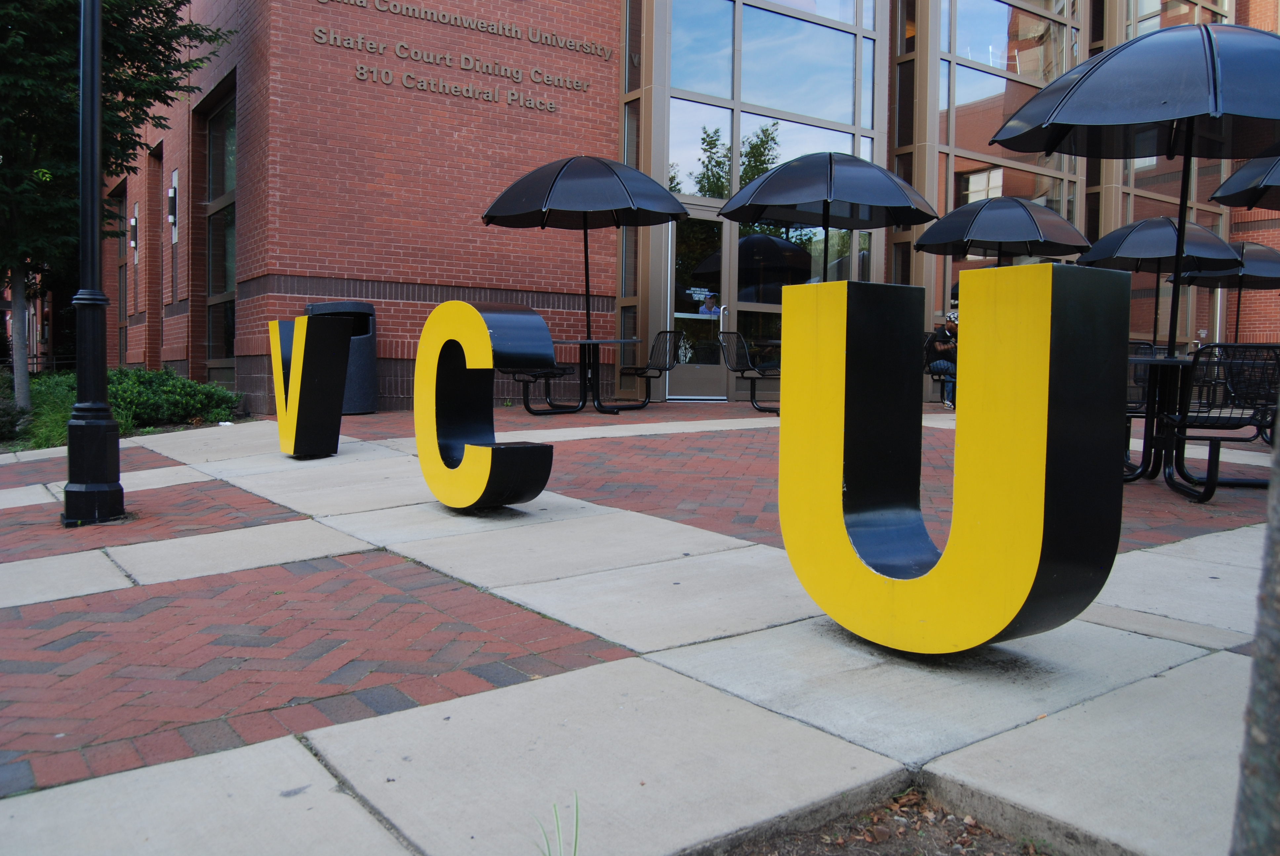
SAEP- Summer Academic Enrichment Program
Location: Richmond, VA at Virgina Common Wealth University Medical College
Compensation: Yes! Housing and Stipend
Website: www.dhsd.vcu.edu
General Info: graduate level course work in either medicine, dentistry, physical therapy or pharmacy. Test skills, admissions workshops, exam reviews
DEADLINE: March 1st

Slide 17
Missouri University Summer Research Internship In Medical Sciences
“The objective of the program is to recruit underrepresented racial and ethnic groups to the medical school with the goal of improving diversity and inclusion in the clinical medicine workforce.”
9 Week Program (Wednesday, May 30, 2012 – Friday, July 27, 2012) with travel days being Tuesday, May 29, and Saturday, July 28
Will live on campus in air-conditioned housing (double rooms), full meal plan covered by the program
Interns provided with funds to cover one hour of academic/research credit, travel to and from Colombia, and a $3400 stipend
Students work on own research project under guidance of MU School of Medicine faculty mentor and will present results at a poster forum at end of summer (July 26)
Deadline: March 16, 2012
http://medicine.missouri.edu/internship/

Slide 18
Case CFAR Minority HIV Research Training Program (MHRTP)
Research program for undergraduate students interested in doing research on HIV/AIDs
Cape Fear Research Center in Cleveland, Ohio
$3500 stipend (duration of 8 weeks)
Up to $1000 additional is available to be applied towards travel to and from Cleveland, or towards on-campus housing
Deadline: February 10, 2012
http://cfar.case.edu/mhrtpprogram.htm

Slide 19
Health Career Connection Paid Summer Internship
Paid summer internship ($3,000-$4,000 stipend)
Ten weeks, full-time (40 hours /week)
Internship placement in one of HCC Regions: Northern California, Southern California, Central Valley, Coachella Valley, New England, New York/New Jersey and North Carolina.
An apprenticeship model enables interns to have a dedicated project to complete while preceptors and HCC staff provide guidance and mentoring
Professional development workshops and internship site tours
Lifetime membership to HCC Alumni Association and access to HCC’s vast network of health professionals
Connection to health-related job opportunities
Deadline: Feb 6th, 2012
www.healthcareers.org

Slide 20
Summer Undergraduate Research in Pharmacology
The Summer Undergraduate Research Program provides "hands on" research experience for sophomores and juniors in the area of molecular pharmacology.
The program begins May 29th, 2012 and runs for ten weeks, ending no later than August 3rd, 2012.
Where: Case Western Reserve University Cleveland, Ohio
Compensation: Stipends of $3,000 will be awarded to all participants. Lodging and food allowance will also be provided.
Deadline: February 17th, 2012
http://pharmacology.case.edu/education/surp.aspx

Slide 21
College Qualified Leaders Program
College Qualified Leaders (CQL) program! Sponsored by George Washington University and the Department of Defense, the CQL program offers interested undergraduates and graduates the opportunity for a research internship in a DoD lab. Internships are available year round and for the summer only.
There is no deadline for applying and applications are accepted all year
https://www.usaeop.com/application/student1.aspx

Slide 22
Amgen Scholars Program
The Amgen Scholars Program is geared towards students in biology, chemistry, and biotechnology fields.
Eligibility: Students must be current sophomores through non-graduating seniors, must be attending a four-year university, and must be U.S. citizens or U.S. permanent residents. A minimum GPA of 3.2 is required.
Support: Amgen Scholars will receive a $5500 award, round-trip air transportation, a generous housing allowance, and a food allowance.
Deadline: February 15, 2012.
Questions about this program can be directed to Carol Casey at casey@caltech.edu.

Slide 23
MED Program
The MED Program provides rigorous academic preparation for rising college seniors and postgraduates planning to apply to medical or dental school in the fall.
What goes on in this program?
Class in Gross Anatomy, Biochemistry, Microbiolog, Histology, Dental Theory & Technique
MCAT/DAT Preparation
Individualized work in learning, study, and test-taking skills will be provided in addition to pre-professional counseling, seminars, workshops, and orientation to the medical and dental school environment.
workshops, panels, and discussions with admissions representatives and students from UNC School of Medicine and Dentistry
Seminars throughout the program, range in topic from professionalism, cultural competence, Kidney Care, HIV/AIDS, health disparities, translational research, medical education, clinical specialities, and balance of work and life.
When & Where: The program lasts for nine (9) weeks and typically starts the last week of May and ends the last week of July. It is held on the campus of UNC-Chapel Hill at the Schools of Medicine and Dentistry.
Deadline: February 3rd
https://omeapps.med.unc.edu/unccoemed/

Slide 24
CONGRATULATIONS COURTNEY!

